Slide 1
Problem Manage a Server Outage Scenario & an Issue & Change Request Management System
Module Project
Module: NICF Capstone Project using Java
Course: NICF Advanced Certificate in Software & Applications (Development & Deployment)
Start Date : 14 October 2022
End Date : 14 October 2022
Submission Date : 14 October 2022
Learner Name : Ida Bagus Ketut Yoghantara
Enrollment ID : BDSE04-0322
Presentation Date :

Slide 2
Contents
Document History
Version Number | Effective Date of release | Summary of Included Changes | Author
1 | 4th March 2016 | First Edition | Satya CVS
2 | 23rd Jul 2018 | Changed for Module 6 | Shrinivas K R

Slide 3
Contents
Contents
S. No. | Description
01 | Principles of Problem Management
02 | Problem Management Example
03 | Tools, Process & Technologies
04 | Investigation & Diagnosis
05 | Explain Prioritization
06 | Problem Management Solution
07 | Systems you will Implement
08 | Project Milestones & Tasks
09 | Milestone Feedback & Action taken
10 | Modifications Made based On Feedback
11 | Project Results
12 | Proposed Improvements

Slide 4
1. Principles of Problem Management
Principles of Problem Management
Problem Identification A problem can be detected within an incident report or an analysis of an existing incident. In order to prevent future service interruptions, proactive problem detection is very important.
Problem Logging It's crucial to document issues for later reference. Details about the problem, such as its kind, description, related events, category, user information, status, resolution, and closure, must be recorded. To tag known problems and manage them in a database, this information is essential.
Problem Investigation An investigation into the root cause of a problem also depends on the severity and urgency of the problem. Common investigation techniques include reviewing the Known Error Database (KEDB) in an effort to find similar problems.

Slide 5
1. Principles of Problem Management
Principles of Problem Management
Resolution Once resolved and the solution is determined, it can be implemented using a standard change procedure. It is also important to ensure service recovery. In order to fix the problem permanently a new change has to be raised.
Review During this stage, it is important to review the resolution of the problem, and its impact on the business as well as carry out a risk analysis. This ensures that the problem management process is carried out smoothly and continually improved for the future.

Slide 6
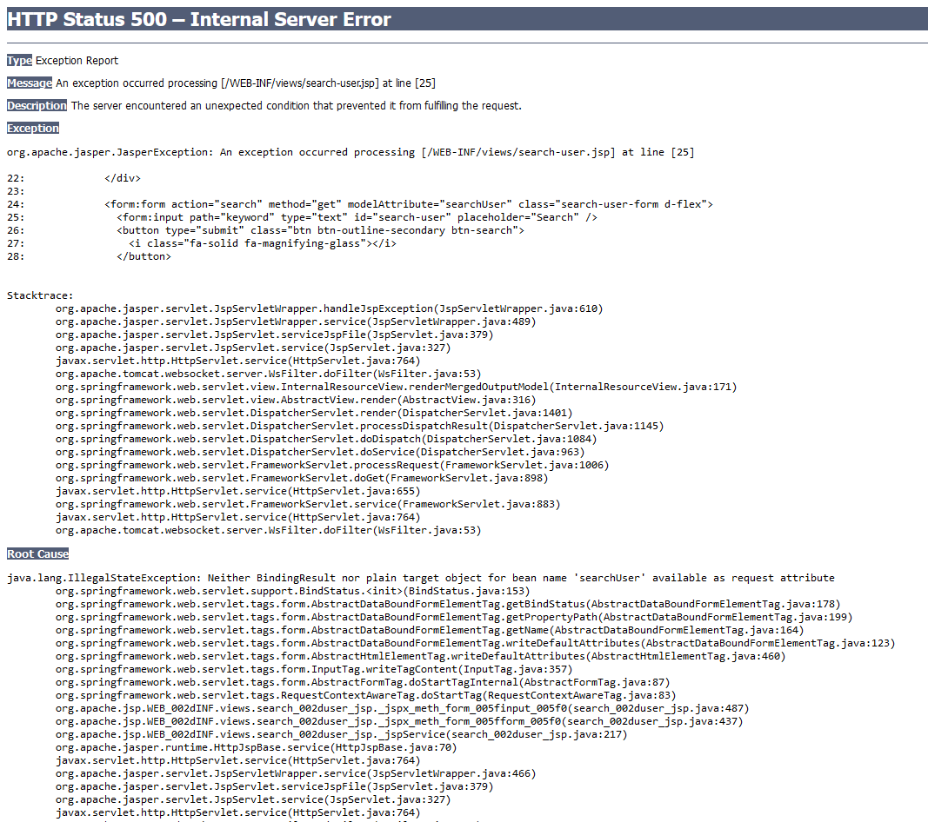
2. Problem Management Example
Problem Identification Error from the development process, the root cause is “Neither BindingResult nor plain target object for bean name ‘searchUser’ available as request attribute”
Problem Investigation It likely because the object model hasn’t mentioned in the controller

Slide 7
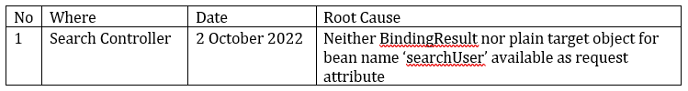
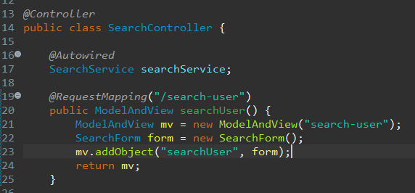
2. Problem Management Example
Problem Logging
Resolution Create object instance of SearchForm, add object to ModelAndView and named it ‘searchUser’
Review Because the error caught upon the development process, it’s not really affecting the application much. In the future development it will be better to check the problem logging first to avoid the same problem to occur

Slide 8
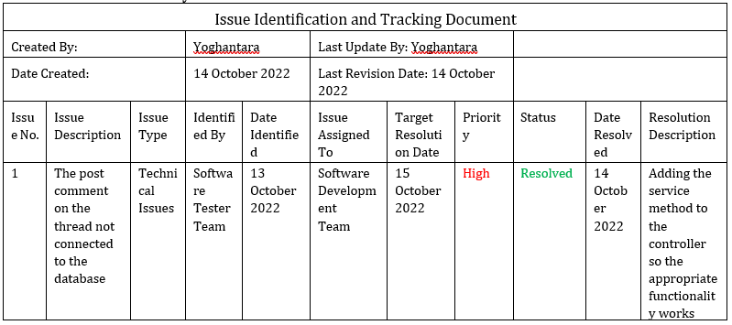
3. Tools, Process & Technologies
Tools, Process & Techniques
Problem Logging
Techniques = Issue Tracking System Issue tracking systems are used to record the progress of issues in software applications so that problems and their status can be more easily identified.
Tool = Excel sheet Using an Excel sheet to make a tracking document template is an important tool for issue identification.
Process:

Slide 9
3. Tools, Process & Technologies
Problem Investigation
Techniques = Root Cause Analysis Tool = Fishbone The Fishbone is an excellent visualization tool for discovering multiple root cause. It shaped like the skeleton of a fish, with the head on the right side being the effect of the problem and the possible causes shown as fish spine on the left Process:
1. Clearly define the problem statement.
2. Add categories of possible causes as fishbones.
3. establish cause and effect between the root cause and the problem.
4. categories and priorities primary and secondary causes.

Slide 10
3. Tools, Process & Technologies
Problem Resolution
Techniques = Known Error Database Known Error Database (KEDB) is a database of all known problems that been documented by the software developer application. Tool = Excel Sheet Using an Excel sheet to make a tracking document template is an important tool for issue identification. Process:
Adding known error records
Accessing known error records
Search KEDB and apply fix
Permanent solution implemented

Slide 11
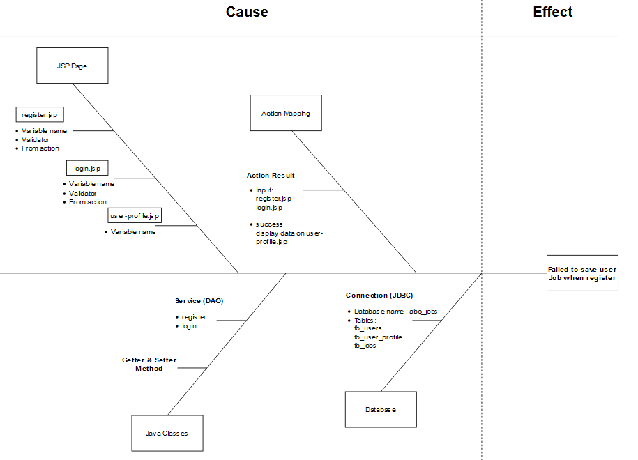
4. Investigation & Diagnosis
Investigate the problem

Slide 12
4. Investigation & Diagnosis
Diagnose the problem
Diagnosing the root cause:
“Value not present”
It most likely because the jsp form value for job is not present any value

Slide 13
5. Explain Prioritization
Prioritize and Categories problems:
Tier 1: Low priority issues The first tier is for basic or minor problems.
Example: Typo for some words on the website
Tier 2: Medium priority issues The second tier is the major problems Example: Register page is not working and not saving to the database
Tier 3: High priority issues The third tier is the critical problems Example: Website server down, Hacker attacks the website

Slide 14
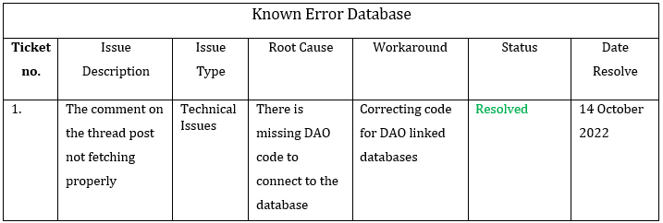
6. Problem Management Solution
Case problem: User comment on the thread post not showing properly after the user posting a comment.
Solution:
Check the controller and service method that fetching the comments database
Fix the appropriate function/method
Test the functionality
After the problem is resolved, write down the problem in the table KEDB to avoid their reoccurrence
Known error Database (KEDB)

Slide 15
7. Systems you will Implement
Apply Job
Users (Software Programmer)
- List Job Page
- Apply Job Functionality
- Apply Job History
- Search Job Functionality
- User Job Page
Admin
- Manage Jobs
- Manage Job Applicants

Slide 16
7. Systems you will Implement
Threads
List Thread
Search Thread Functionality
Post Thread
Edit Thread
Read Thread
User Thread
Comment Thread

Slide 17
8. Project Milestones & Tasks
Project Task ID | Project Task Description | Project Milestone ID
1 | Identify problems and develop issue tracking documents | 1
2 | Problem investigation and diagnosis | 1
3 | Problem prioritization | 1
4 | Problem resolution | 2
5 | Creating a known error database | 3

Slide 18
9. Milestone Feedback & Action taken
Project Milestone ID | Milestone Feedback received from Tutor / Learning Facilitator | Action Taken (Yes / No)
1 | Creating fishbone technique with diagram.net | Yes

Slide 19
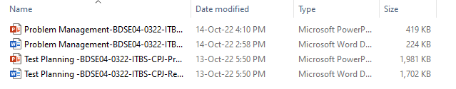
11. Project Results
List evidence of the project Results

Slide 20
12. Proposed Improvements
List of Improvements
Making sure to document the problem management

